Slide 1
Analysis of Social Chatter vs Market Results, post IPO
Jacob Vissering, Viny Nair, Niki van Dyck

Slide 2
Executive Summary
Prior to filing an initial public offering(IPO), a privately held company's value is largely a guess. While the company needs to meet IPO criteria, by providing insight into income, assets, revenue growth, etc. Pre-IPO companies don't have any feedback or demonstrated buyer history to measure the immediate purchase of its shares at a particular price.
This analysis measures social queues to market movements in an attempt to find a correlation.
Notes:
Prior to filing an initial public offering(IPO), a privately held company's value is largely a guess. While the company needs to meet IPO criteria, by providing insight into income, assets, revenue growth, etc. Pre-IPO companies don't have any feedback or demonstrated buyer history to measure the immediate purchase of its shares at a particular price.
This analysis measures social queues to market movements in an attempt to find a correlation.

Slide 3
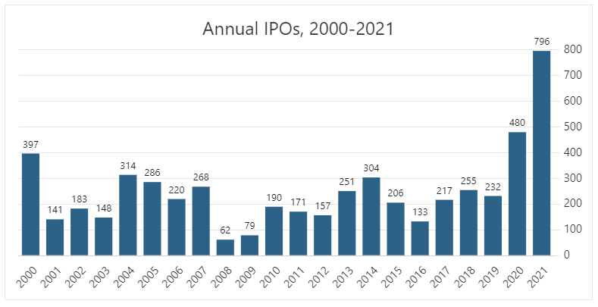
WHY?
Footnotes https://stockanalysis.com/ipos/statistics/
Notes:
From 2019 - 2020 the number of companies that IPO’d more than doubled (232 in 2019 vs 480 2020) . As of There have been 796 IPOs on the US stock market in 2021, which is an all-time record. As of October 11, 2021, this is +161.0% more than the same time in 2020, which had 305 IPOs by this date.

Slide 4
Concept
When companies IPO there is no historical trade activity to complete financial modeling analysis. Our analysis reviews social chatter for 90 days from the IPO launch to see if it could be used as a mechanism to determining future stock fluctuations and/or trading volume.
The overall motivation for this project was the general excitement in the uptick of IPO’s and the curiosity of finding a way to validate or predict market prices and volumes.
Notes:
Needed three points/ Analyst Description, Motivation, User story
When companies IPO there is no historical trade activity to complete financial modeling analysis. Our analysis reviews social chatter for 90 days from the IPO launch to see if it could be used as a mechanism to determining future stock fluctuations and/or trading volume.
The overall motivation for this project was the general excitement in the uptick of IPO’s and the curiosity of finding a way to validate or predict market prices and volumes.

Slide 5
Data Techniques
Data Source
List of companies that IPO’d
This list was used to determine 15 samples
Twitter
A general public use software named snscrape was used to scrape twitter. This allowed us to pull lots of raw twitter data while also setting certain criteria.
Stock data
The Alpaca API was used, as we had a working knowledge of the API and it met time constraints.
Notes:
Needed three points: Description of data source, Reasoning for data selection, Collection, exploration and cleaning process
Data Sources:
IPO List
Twitter - SNScrape used to pull raw data
ALPACA SDK for Stock Data

Slide 6
Data Collection & Cleaning
SNScrape
90 days Twitter Data in .json format - Going over an output of 100,000 results we found often crashed the program
Created Pandas Dataframes from .json data to clean the data
Once ready, exported the Twitter data to .csv to use in our analysis notebook.
Used Python collections module to count tweets by day
Alpaca SDK
Generally clean data pulls
Formatted datetime to date
Dropped columns that were irrelevant
SQL
Added each individual stocks data (Twitter & Market) as SQL tables and joined accordingly throughout analysis
Notes:
SNScrape
90 days json format
Converted to dataframe to clean
To CSV for analysis
Alpaca SDK
Generally clean data pulls
Reformatted the date
Dropped columns, added columns, etc
SQL
Created tables in SQL so we could join accordingly

Slide 7
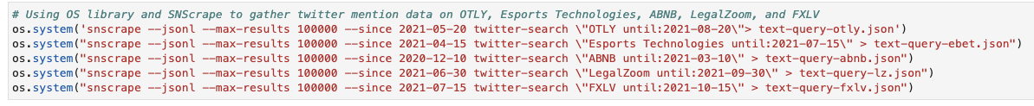
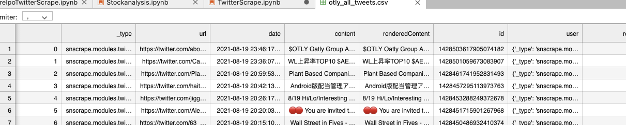
Data Collection & Cleaning
OS Library & SNScrape in action:
Example of raw return from scrape:

Slide 8
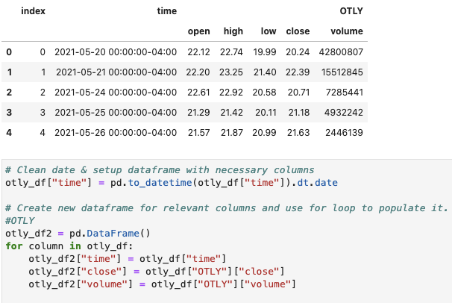
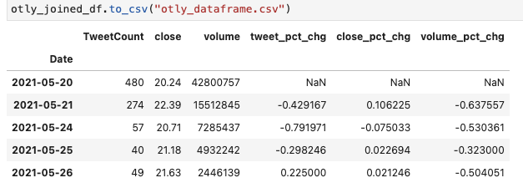
Data Collection & Cleaning
Example of cleaning Alpaca data date & columns
Example of finished dataframe - Ready for Analysis!

Slide 9
Approach Timeline
10/4/2021
10/6/2021
10/11/2021
10/13/2021 - 10/17/2021
Planning
Review Initial Findings - Make Adjustments
Compile Findings & Prepare Analysis
Presentation & Final Edits
Agreed on project subject & scope.
Chose companies & defined next steps.
Discussed data. Decided what worked and what didn’t.
Refined data collection and cleaning process and shared methods.
Reviewed team findings & analysis.
Combined code & visualizations.
Prepared Presentation.
Present to class.
Make final edits to code and analysis in preparation for submittal.
Notes:
10/4 - Planning
10/6 - Review Initial Findings & Next Steps
10/11 - Review individual analysis, combine code & prepare presentation
10/13 & beyond - get ready for final submittal

Slide 10
Approach
Tech
Roles
Challenges
SNScrape
Alpaca SDK
Pandas
Jupyter Lab
hvPlot & Matplotlib
Viny - Lead Coder & Data Cleaner
Niki - Code Collaborator & Project Manager
Jake - Code Collaborator & Data Visualizer
Stock picks based on ticker
Amount of data
Multiple axes graphs
Additional Libraries
Pathlib
Os
Dotenv
Sqlalchemy
Collections
In addition, we all selected five companies to analyze based on the criteria we agreed upon.
Once analysis complete, we combined our findings.
Successes:
Cleaning and joining data
Teamwork

Slide 11
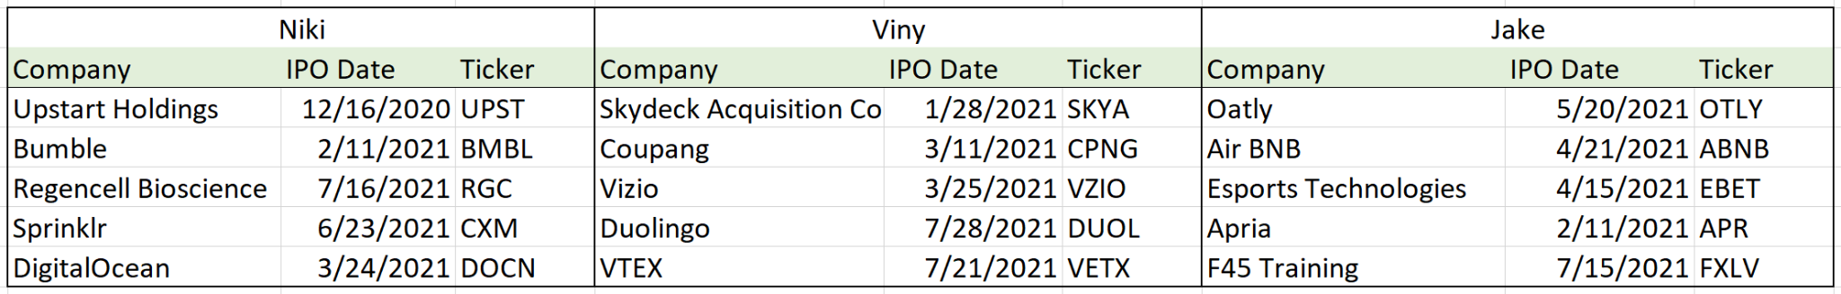
IPO’s Reviewed

Slide 12
Demo
Link
Live run through Jupyter Notebooks & Code

Slide 13
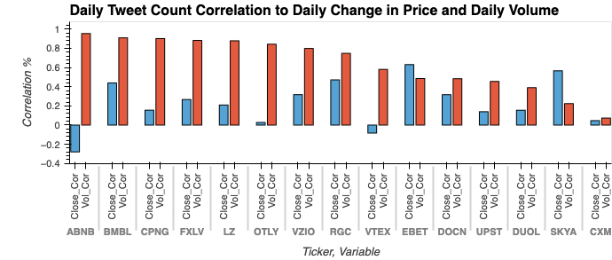
Outcome
The data reflects that there is often a correlation between Twitter mentions and daily stock trading volumes. However, we did not find a correlation in Twitter mentions and price movement.
Notes:
The data reflected that twitter mentions and the trading volume were correlated and sometimes highly.
We did not find a correlation between Twitter mentions and price movement.
Next Steps:
Effects of social influencers
Effects of outspoken CEO
Deep dive in analyzing sentiment of social media posts.

Slide 14
Next Steps
Additional topics to research
The effects of social influencers on stock volumes and price
The effects of CEO tweets, publications, media outlets, on stock volumes and price
Deep dive into defining, researching and analyzing social sentiments.

Slide 15
Links
Project Plan
https://docs.google.com/document/d/1T7t8s_d5W9xqpWABZVNWfyU4WQZtbAmR/edit
GitHub repo
https://github.com/jake-viss/UWFintech_Project1

